Slide 1
Hi-Tech and No-Tech Tools for Engagement & Student Success
Dr. Laurie S. Starkey
Cal Poly Pomona
Chemistry & Biochemistry Department
Research-Based Course Redesign Institute
Cal Poly Pomona, 8/15/17

Slide 2
When/How does the best learning occur?
Well-organized professor
Engaging lecture presentation
Variety of teaching methods employed
makes material accessible
keeps students active and focused
audio, visual, hands-on
interaction with material
Well-defined learning outcomes and clear expectations
Professor cares about student’s learning
Abundant and timely feedback provided
know what the goal is and how to achieve it
Should this matter? Why does it?
assessment, keep on track, improve
Affective Domain
Student sees value in subject matter
Reasonable work/ academic schedule
Student is healthy: sleep/diet/exercise
willing to commit and
“productive persistence”
time available to dedicate to class work
receptive mind/body

Slide 3
How can use of TECHNOLOGY promote learning?
Well-organized professor
Engaging lecture presentation
Variety of teaching methods employed
makes material accessible
keeps students active and focused
audio, visual, hands-on
interaction with material
Well-defined learning outcomes and clear expectations
Professor cares about student’s learning
Abundant and timely feedback provided
know what the goal is and how to achieve it
Should this matter? Why does it?
assessment, keep on track, improve
Affective Domain
Student has interest in subject matter
Reasonable work/academic schedule
Student is healthy: sleep/diet/exercise
willing to commit and
“productive persistence”
time available to dedicate to class work
receptive mind/body

Slide 4
How can a focus on MINDSET promote learning?
Well-organized professor
Engaging lecture presentation
Variety of teaching methods employed
makes material accessible
keeps students active and focused
audio, visual, hands-on
interaction with material
Well-defined learning outcomes and clear expectations
Professor cares about student’s learning
Abundant and timely feedback provided
know what the goal is and how to achieve it
Should this matter? Why does it?
assessment, keep on track, improve
Affective Domain
Student has interest in subject matter
Reasonable work/academic schedule
Student is healthy: sleep/diet/exercise
willing to commit and
“productive persistence”
time available to dedicate to class work
receptive mind/body

Slide 5
Deep, Sustained Learning is Achieved by Building Relationships
RELATIONSHIPS
Teacher
Student
CONTENT
Subject
Teaching & Learning
≠ Information Dissemination

Slide 6
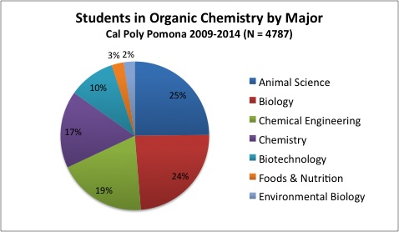
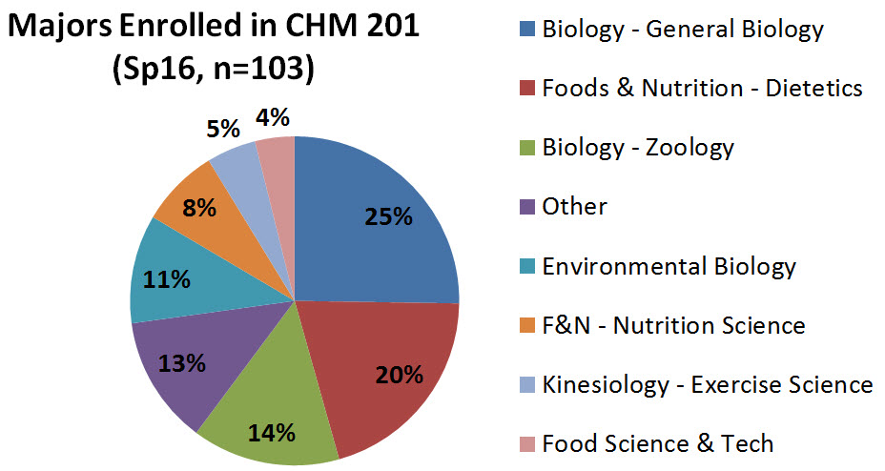
My CSU-CRT Course Redesigns: Organic Chem, a Demanding (& Feared) Course
CHM 315
(2nd quarter of yearlong sequence)
CHM 201
(one-quarter survey course)
Charts show the variety of majors enrolled

Slide 7
Redesign Goal:
Reduce D/F/W Rate
Interventions included both technology and no-tech “mind games”
Improve study skills: lasting impact beyond this course
Low-cost or free interventions: 100% sustainable

Slide 8
A Growth Mindset Fosters Student Success
TWO MINDSETS
BY CAROL DWECK, PhD
Sees effort as the path to mastery
Learn from criticism
Embrace challenges
Persist in the face of setbacks

Slide 9
A Fixed Mindset Can Impede Learning
TWO MINDSETS
BY CAROL DWECK, PhD
Sees effort as fruitless
Ignores useful negative feedback
Avoids challenges
Gives up easily

Slide 10
No-Tech Tools for Improving Students' Mindset, Attitude and Persistence
Promote a Growth Mindset (Carol Dweck)
Encourage self-reflection, thinking about learning (Metacognition, exam wrappers, journals)
Provide a supportive environment (redesigned syllabus)
Facilitate formation of study groups (Organic Learning Communities, OLC)
Focus on improving study skills (Saundra McGuire)

Slide 11
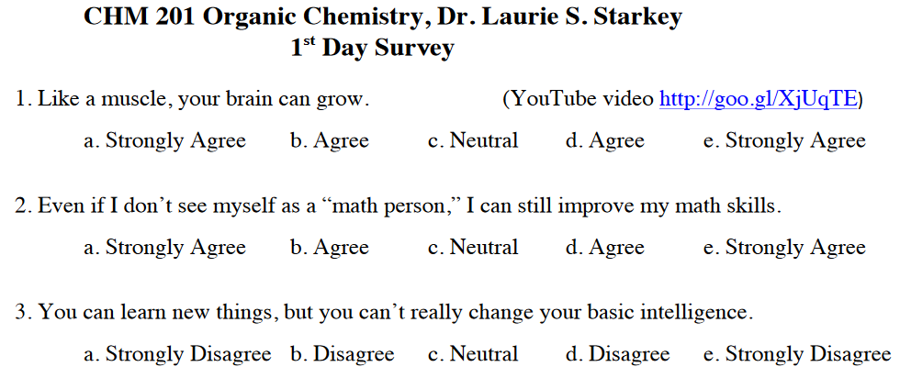
Supplemental Materials: Handouts, Articles, Videos, Modules on Learning Theory
Unconventional mindset “Pretest” reinforces research-based facts
(Neuroplasticity video)

Slide 12
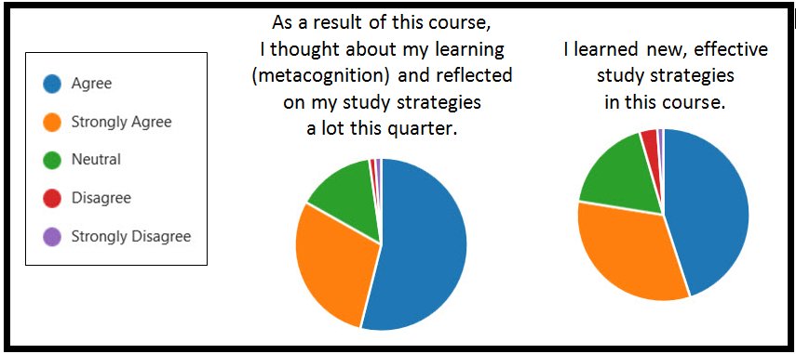
Assessment of Mindset Redesign
Metacognition and Study Skills

Slide 13
Assessment of Mindset Redesign
Students reported that redesign likely improved their grades

Slide 14
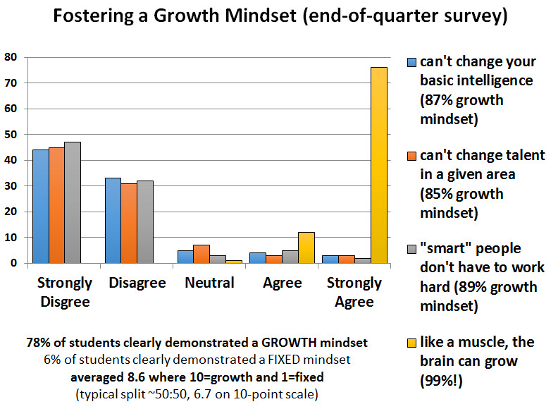
Assessment of Mindset Redesign
Majority (78%) of students adopted a Growth Mindset
Only 6% of students demonstrated a Fixed Mindset

Slide 15
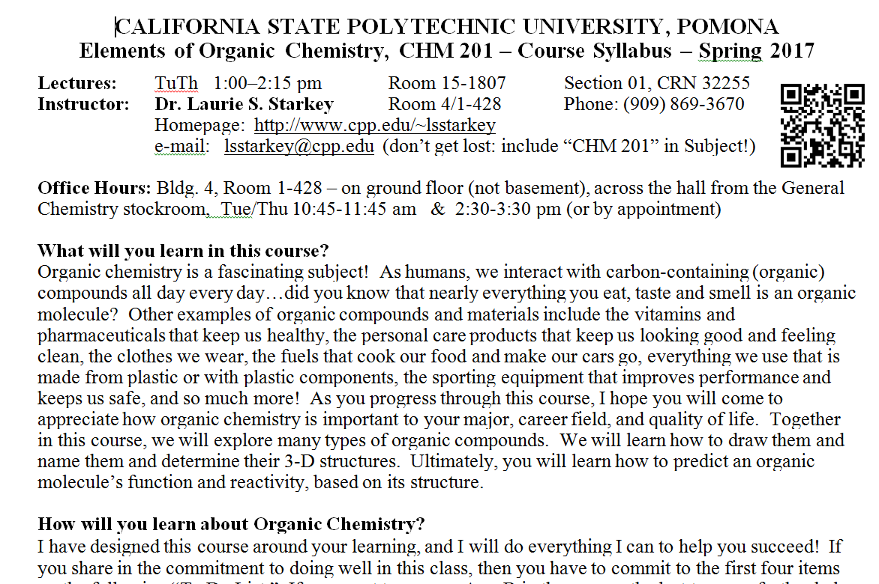
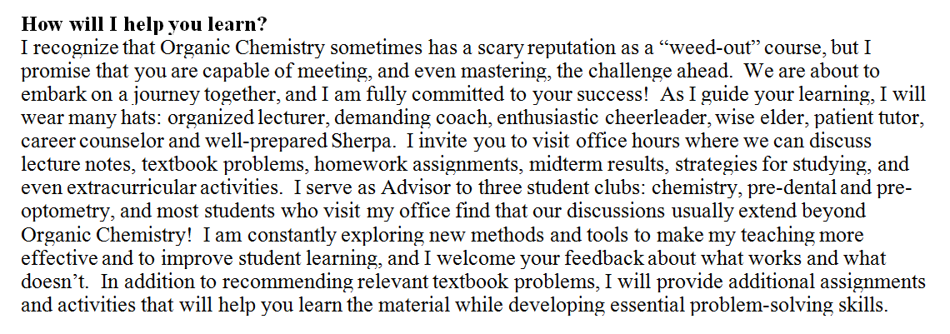
Learning-Focused Redesigned Syllabus
fosters a supportive and inclusive environment
Uses first-person “you will do…” and “I will do…” format
Increases student interest in course
Encourages buy-in

Slide 16
Student Study Groups: Organic Learning Communities (OLC)
Extra credit given for students who formed study groups outside of class
Structured activities were provided for the OLCs on a weekly basis
XC required weekly meeting, Bb journal entry, end-of-quarter reflection on OLC experience
Thanks to Victoria Bhavsar for coordination!

Slide 17
OLC Student Feedback
I found that I was more willing to ask questions and be unsure about topics in my study group than I was with asking during class or even going to office hours (i'm just that type of person).
A study group ended up being extremely helpful because even if not one of us understood something, we all felt a bit less overwhelmed since we knew that we were not alone.
We actually suffered together which was okay because that boosted our confidence towards this class.
I have never been a part of a study group before! I really enjoyed it.
Also we were able to help one another understand difficult topics because we could look at the problems from multiple perspectives rather than relying solely on our own perspective.
I think the fact that we did become friends was also a positive because it can be very difficult to make friends at a school that uses the quarter schedule.
This created a level of support that reduced stress in other areas and allowed me to focus more on my coursework.

Slide 18
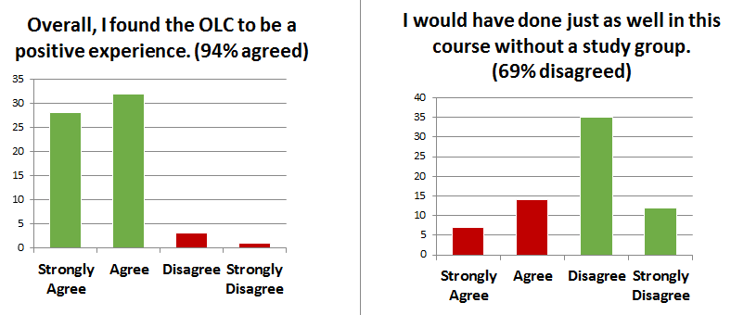
Assessment of OLC Experience
How valuable was OLC study group?

Slide 19
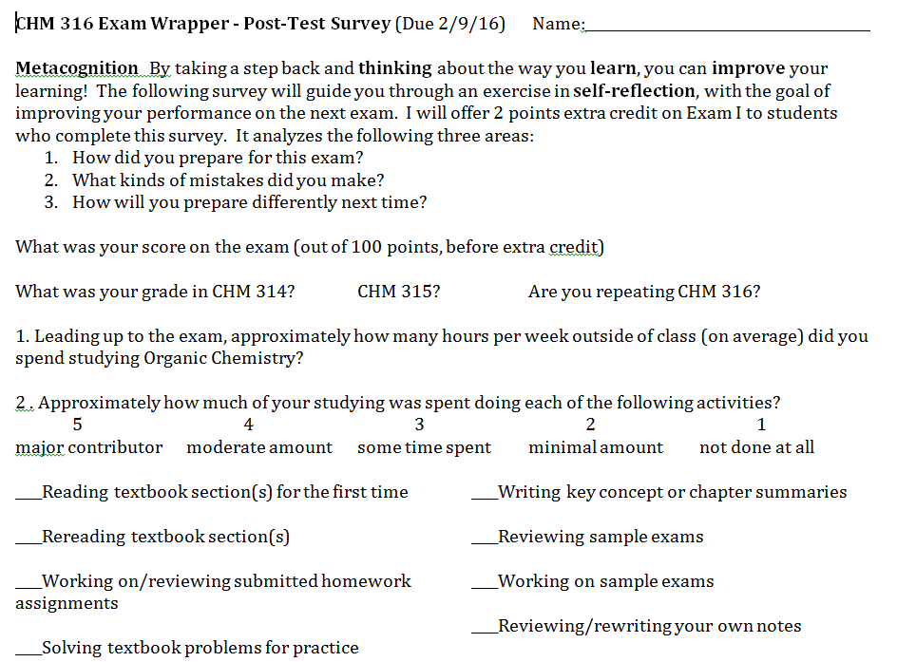
Metacognative Exercise: Exam Wrapper
Survey given after 1st midterm exam
Students reflect on how they prepared, mistakes made
Students consider how they will prepare differently next time
Extra credit offered for wrapper + exam corrections

Slide 20
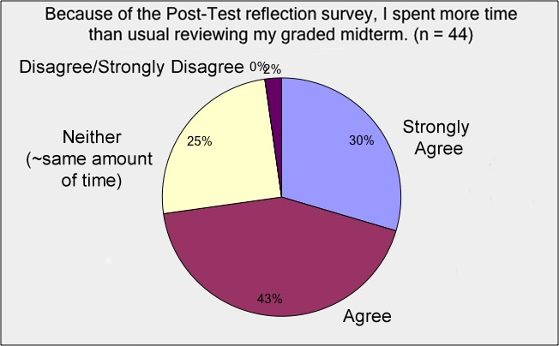
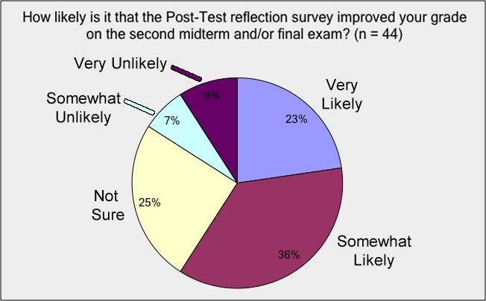
Exam Wrapper Student Feedback
Spent more time reviewing graded midterm?
Improved grade on second midterm?

Slide 21
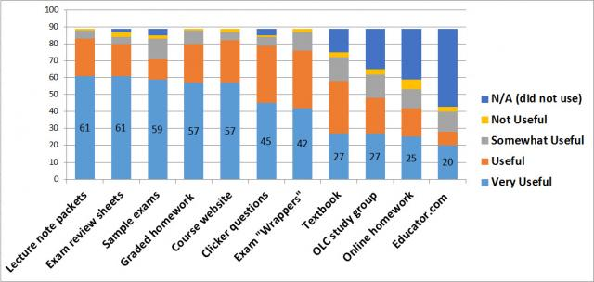
Assessment of Redesign (End-of-quarter survey)
How useful was each course component?

Slide 22
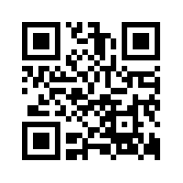
Skeptical Philosophy: I don't use technology for the sake of technology
PowerPoint presentations can be boring and passive; a “chalk” talk is much more engaging! (when I write, they write)
Teaching with Technology, my personal journey
1996 Website www.cpp.edu/~lsstarkey
2000 Distillation image map (Photoshop)
2001 Online pre-lab quizzes (WebCT/Bb)
2002 Calibrated Peer Review (CPR)
2007 Pre-lab online tutorial videos
2008 Classroom Response System (iClicker)
2014 Using online homework in Organic Chem Classes...
2017 Shared documents, surveys (like Google Docs), Bb journals
QR Code for my homepage

Slide 23
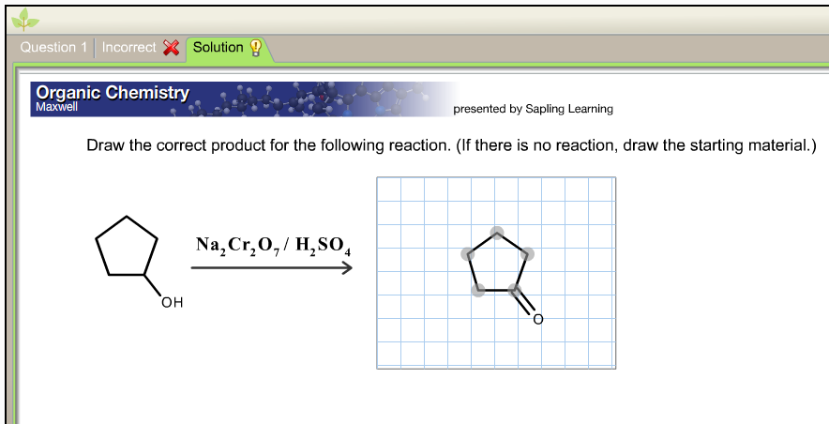
Tech-Assisted Student Learning
Online homework from publisher (immediate feedback, autograding)
Skill-building, drill-type quizzes (can create in LMS)
Adaptive learning
measures competency level for each SLO and customizes assignments
Ideal for students with weak pre-requisite skills

Slide 24
Technology for Lab Preparation
Online Quizzes (WebCT, Blackboard): instant feedback, assessment
Online Tutorials (Adobe Presenter, Flash/HTML5 animations, filming of demos, captioning) http://www.cpp.edu/~lsstarkey/ochemlab over 36,000 worldwide visitors to website since 2008
Benefits: unlimited time, asynchronous, reviewable, available in the future (website/YouTube vs. LMS)

Slide 25
Assessment of Technology Prelab Quiz: Overall Score
Spring 2007: 29 students watched entire video; 7 watched some
Mean = 30/65
Mean = 50/65

Slide 26
Assessment of Technology Prelab Quiz: Sketch Distillation Apparatus
Percent of Students at each Score (Max Score = 10 points)

Slide 27
Assessment of Technology Prelab Survey: Confidence in Running Distillation Experiment
Mean = 5.0
Mean = 7.6

Slide 28
Tech-Assisted Lab Preparation: Student comment
“I have never before taken a lab course at this university where so much help was provided for preparing for the lab. Between the Blackboard quizzes and online tutorials I always felt I had enough preparation for the lab, and this helped me perform better and understand the actual experiment.” CHM 317L, Fall 2012

Slide 29
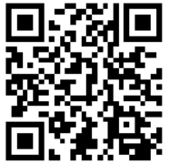
Tech-Enabled Classroom Engagement
Demos, simulations and animations on YouTube CHM 315 (free, no hazards, can pause/watch later, etc.) to find resources: MERLOT.org
“Clickers” (CRS) www.clickerquestions.com
Kahoot – gameshow-style M/C questions using mobile devices getkahoot.com
TodaysMeet – smart phone chat tool todaysmeet.com/cppredesign
Class participation resources, including low-tech! www.stephenbrookfield.com (Workshop Materials link)
QR Code for TodaysMeet

Slide 30
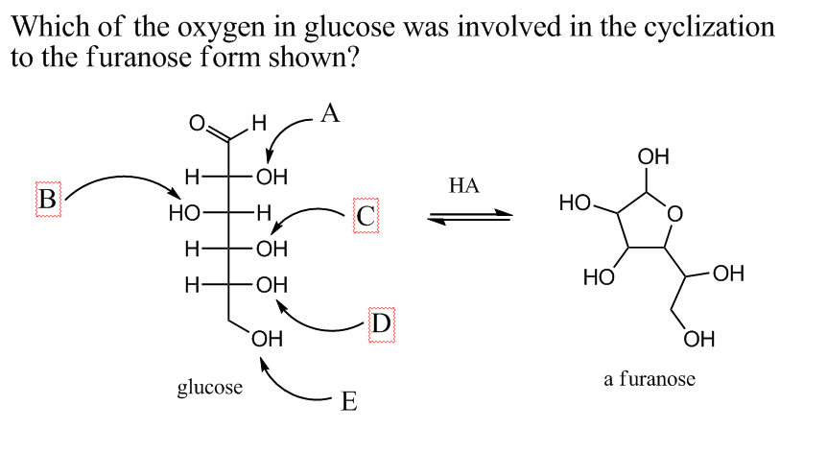
Technologies for Classroom Engagement
iClicker (CRS)
transition/wrap-up
formative assessment
exam review

Slide 31
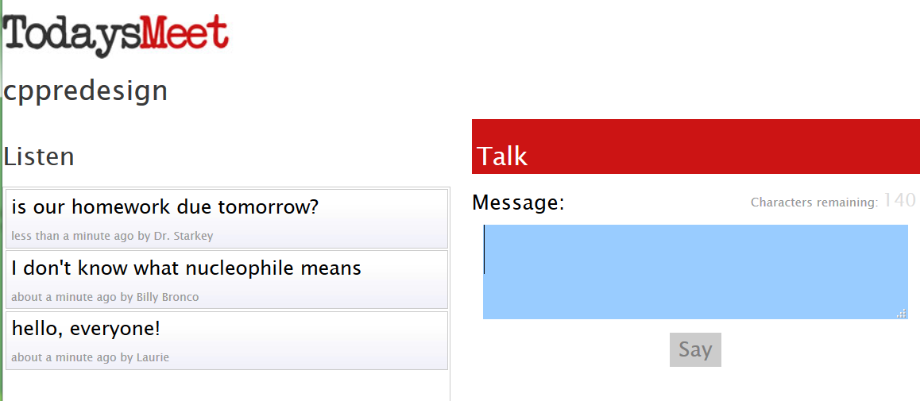
Technologies for Classroom Engagement
TodaysMeet
smart phone chat tool
todaysmeet.com/cppredesign
QR Code for TodaysMeet

Slide 32
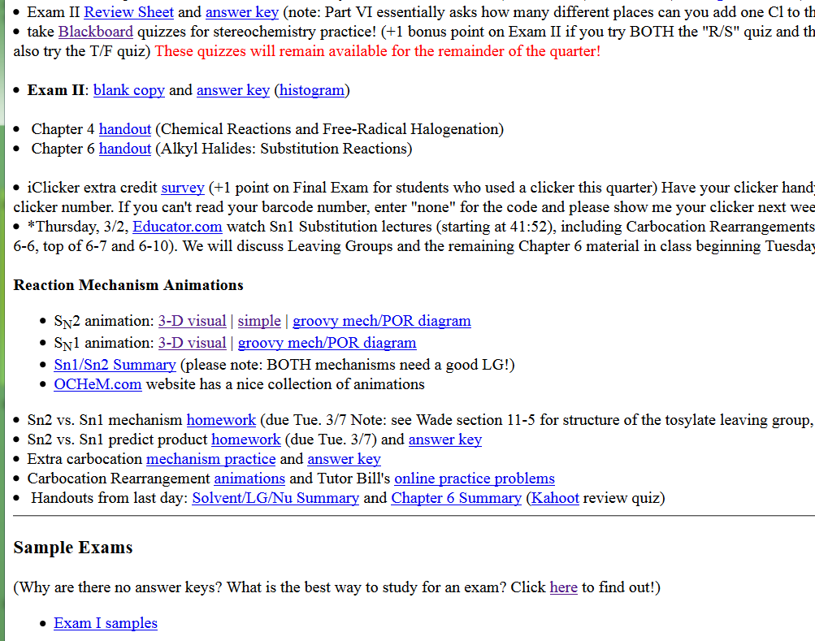
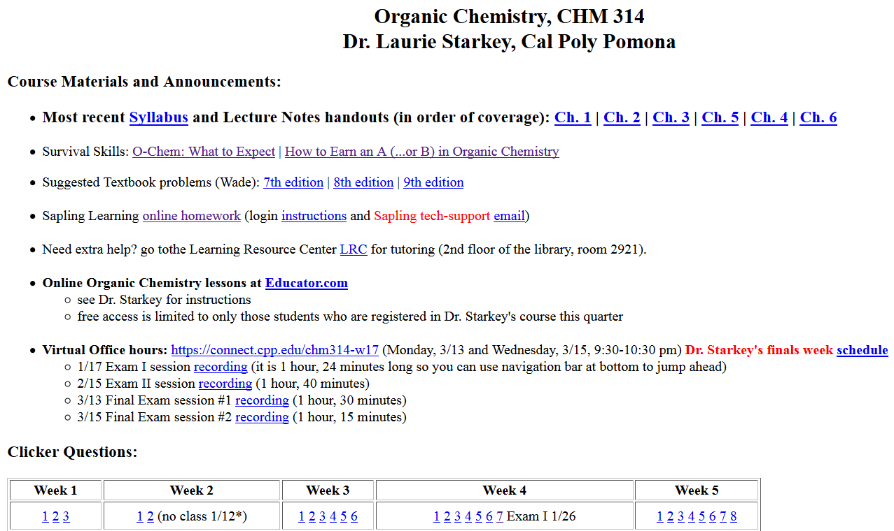
Tech-Enabled Communication
Course Homepage: Blackboard vs. Public
handouts, sample exams, answer keys, clicker questions, links to resources

Slide 33
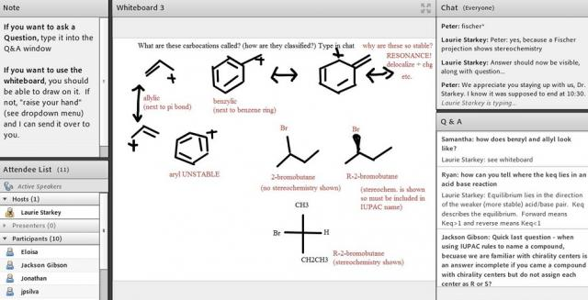
Tech-Enabled Communication
Virtual office hours (Adobe Connect)
the night before each exam, 9:30-10:30 pm
can record sessions

Slide 34
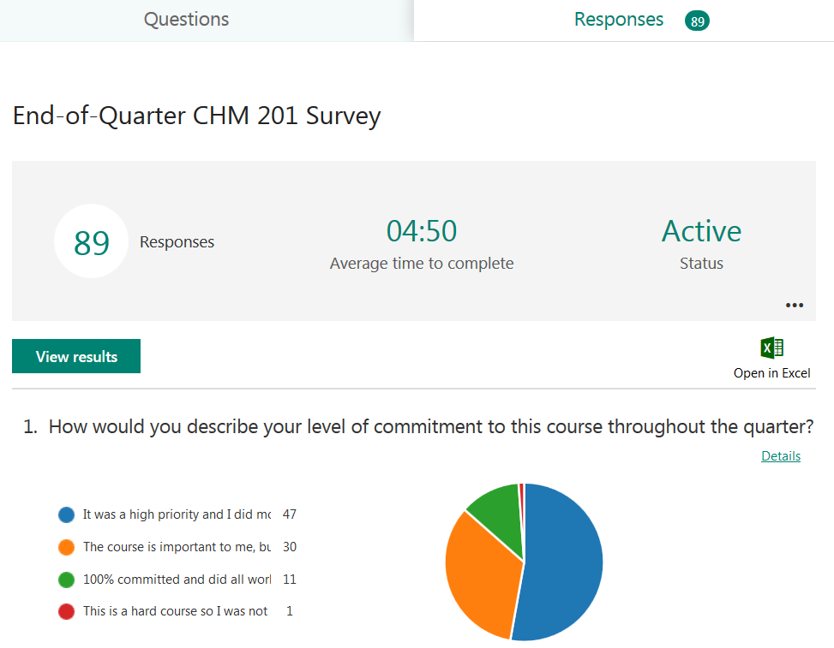
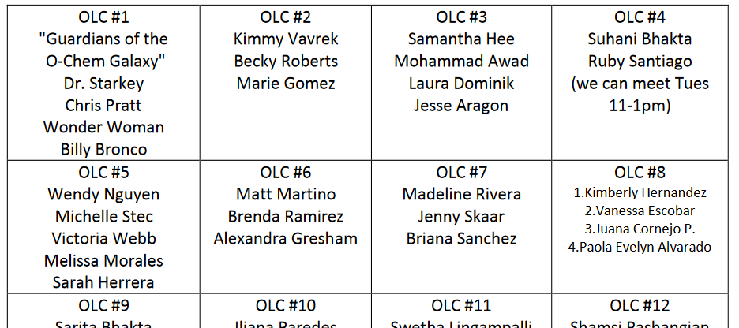
Tech-Enabled Communication
Microsoft OneDrive
Forms: surveys, tracking
Word docs: study group rosters

Slide 35
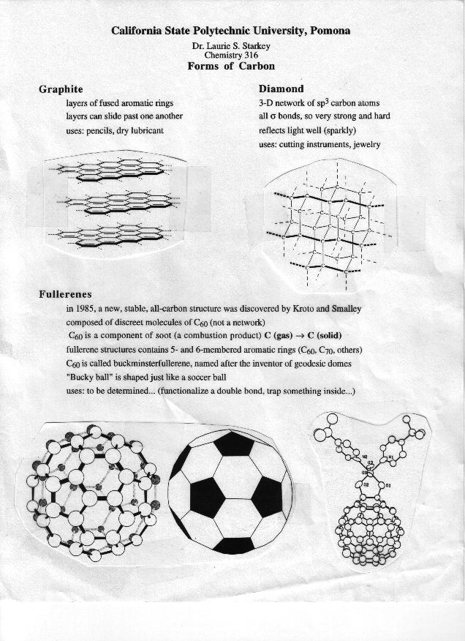
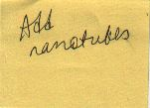
Teaching Innovation Inspired by Faculty Learning Community (CPP FCPD)
Old-school approach
Handout from ~1997
Previous goal: revise handout
Tech-assisted approach
Make a wiki! Voicethread
Extra credit assignment PBWorks.com

Slide 36
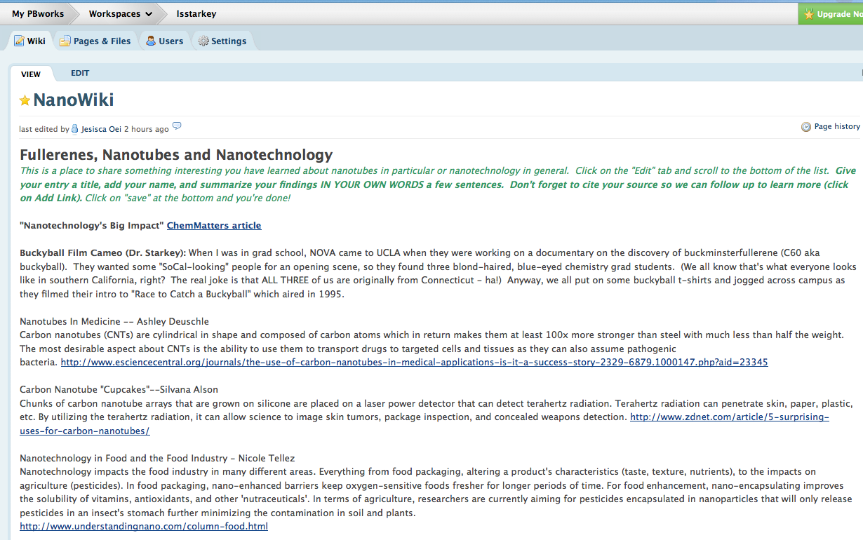
Nanotube Wiki

Slide 37
Nanotube Wiki: Student Comment
“'Asbestos warning' on nanotubes (By Jonathan Fildes Science and technology reporter, BBC News) As a Biology major, I thought that looking and researching about nanotechnology would be dull and boring. It proved to be really interesting. There are so many wonderful things being written about nanotubes and how they can make a huge impact despite their "nano" size. I was wondering if there were any sort of risks that came along with this new technology. I came across an article that was put out by BBC News about the possible negative effects of nanotubes. The researches compared the molecular structure to that of asbestos, which earlier cause a pandemic of lung disease in the 20th century…. As a bio major, its interesting and exciting to see the worlds of Ochem and Bio clash. Here is the link to the article. I found it really interesting. :)”

Slide 38
Making videos for the flipped classroom & beyond
Online lectures – search YouTube, Educator.com, EdX
Create your own! “Old school-style” recording of narrated homework solutions (iPhone) 3D sketch reagent table
Latest technology: transparent lightboard! (Biology example)
Record and edit videos with Camtasia (screen capture/voice) Tutorials: http://tiny.cc/CreatingPedagogicalVideos Examples: Engineering tutorial and solved problem
Lecture-capture w/iPad apps - can export videos to YouTube Explain Everything cyclohexane and Doceri CPP Engineering

Slide 39
Sharing your work
Private (LMS) or Public (webpage link, MERLOT)
Include captioning for accessibility (Hablas Español? Si!)
Maximum exposure: make a YouTube channel!
ChemistryConnected, created in 2012, has over 422,000 views and over 870 subscribers
Pre-lab tutorials, solved problems, demos of hands-on elementary school science activities
Over half the views have come from outside the U.S. (200 different countries) http://www.youtube.com/user/ChemistryConnected

Slide 40
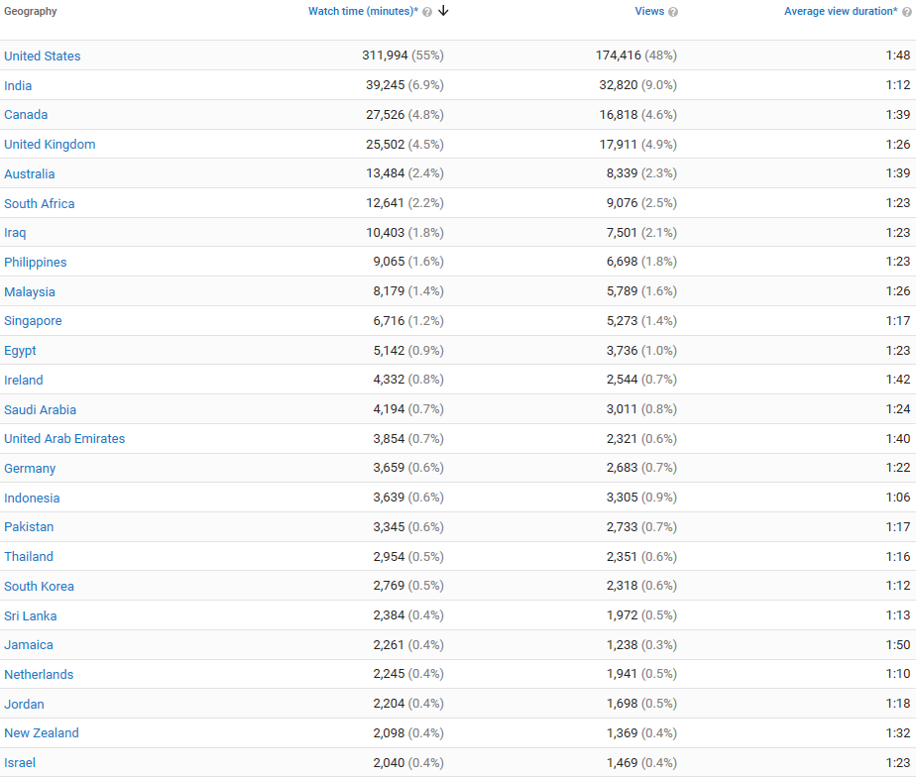
Chemistry Connected YouTube Channel

Slide 41
Making it Academic – SoTL Research
Turn your innovation into a research project!
Formulate a question
Collect data (can be a great “wow” factor)
Get IRB approval (Human Subjects)
Pre- vs. Post-Intervention
Quantitative and Qualitative data
Perform assessment; analyze data
Share results with colleagues and the world!
Conference paper, Ed. Journal article, RTP

Slide 42
Getting Buy-In and Support from Students, Faculty, Institution
Poorly implemented interventions unlikely to succeed
If you are enthusiastic, students are likely to be too
Explain WHY you do what you do – pedagogy matters!
Share data and testimonials and data with colleagues – encourage a SoTL-supportive culture
Institutional $upport: workshops, summer institutes, release time, mini-grants, free iPads (!), Faculty Learning Communities (clicker, SoTL, technology)
Collaborate with research students, other institutions…

Slide 43
Variety in Teaching = Engaged Students
Audiovisual presentations blows away text
Interactive lessons exercise different “muscles”
Teaching to learning styles is a “neuromyth,” but captioning is helpful for ALL learners
Online tools offer asynchronous and mobile delivery, pause button, unlimited replay, etc.
Most students need more than textbook support! Online homework and adaptive learning tools enable immediate feedback/ formative assessment

Slide 44
Technology to Improve Mindset: Tapping into the Affective Domain
How the student feels about the class affects learning! (technology-infused learning can be fun, interesting, engaging, informative, helpful, shiny and new) Our students are digital natives and expect technology.
How the teacher feels about the class affects teaching! (technology-infused teaching can be fun, interesting…)
Students learn better if they feel the instructor cares about their learning. Students appreciate the effort you put in to support their learning. A better attitude about you, about the class, and about the subject can lead to better learning!

Slide 45
Support & Acknowledgments
CPP Faculty Center for Professional Development Investigating Teaching & Learning Fellowship, Connecting Learning & Technology FLC, Clicker FLC, countless workshops
CPP eLearning (I&IT), CPP Mediavision Flash animations & video production
CSU Course Redesign with Technology Grants x3 Summer Institute + Course Release + Stipend
CPP SPICE Grants x2 Paid for online homework, stipend to support CSU-CRT
CSUPERB Grant (CSU Biotech. Education & Research) Summer stipend to create pre-lab tutorials

